Slide 1
Applying Human-Centered Design Techniques to Design a Task-centered Project Management Tool
Lukas Langlechner, 27.03.2017, Munich

Slide 2
Outline
Motivation
Human-Centered Design
Approach
Hackathon Planning Process
Interviews
Workshops
Results
Evaluation
Limitations & Future Work

Slide 3
Motivation
Collaborative processes are becoming increasingly important
Managing tasks in a project central to collaboration
Plethora of different tools exist to facilitate task management
Tools are based on certain approach to task management
Team‘s approach might differ from the tool‘s
→ Designing a Tool based on the user‘s actual approach to task management

Slide 4
Outline
Motivation
Human-Centered Design
Approach
Hackathon Planning Process
Interviews
Workshops
Results
Evaluation
Limitations & Future Work

Slide 5
Human-Centered Design (1)
Human-centered design is a creative approach to interactive systems development that aims to make systems usable and useful by focusing on the users, designing around their needs and requirements at all stages, and by applying human factors/ergonomics, usability knowledge, and techniques.
This approach enhances effectiveness and efficiency, improves human well-being, user satisfaction, accessibility and sustainability; and counteracts possible adverse effects of use on human health, safety and performance.
ISO 9241-210

Slide 6
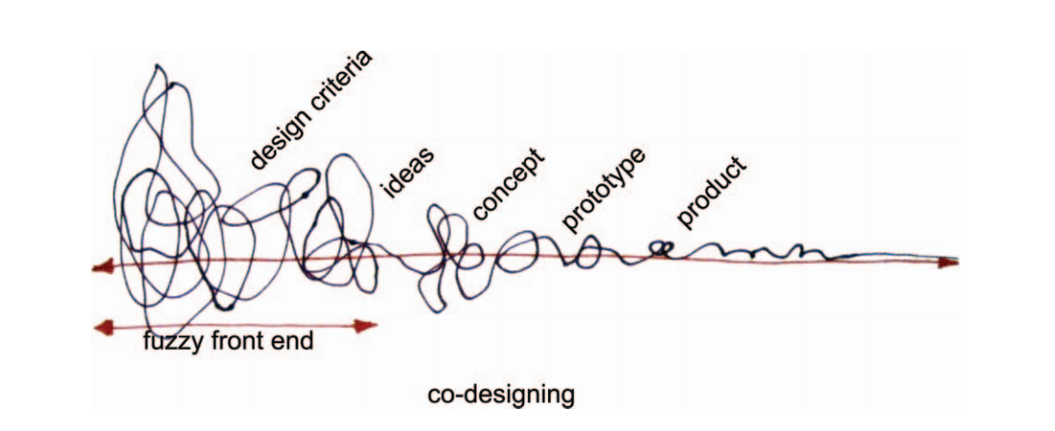
Human-Centered Design (2)
Users and their needs must be central to system design
Users must be the focus at all steps of the development process
Focus in this Thesis: Involving users at the Fuzzy Front End
HCD Approaches can be differentiated by two dimensions:
  Whose knowledge is privileged?
  Which knowledge is privileged?
[Sa08] Sanders, E.: Co-creation and the new landscapes of design

Slide 7
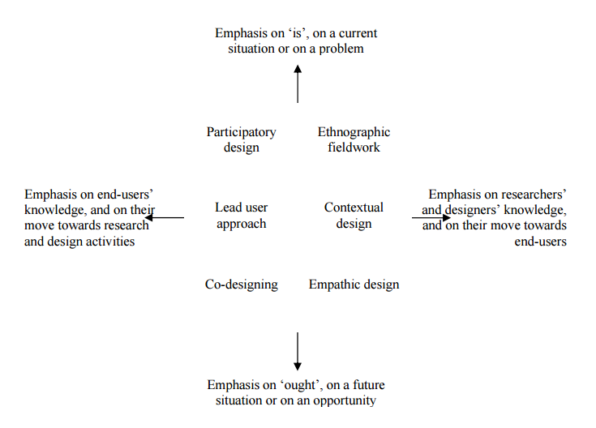
Workshop – HCD influences
[St08] Steen, M.: Early user involvement in research and design projects – A review of methods and practices

Slide 8
Outline
Motivation
Human-Centered Design
Approach
Hackathon Planning Process
Interviews
Workshops
Results
Evaluation
Limitations & Future Work

Slide 9
Approach
Identifying Example Process
Interviews
Workshops
Concept Development
Paper Prototype
Evaluation

Slide 10
Hackathon Planning Process – Key Facts
Hackathon
Event at TUM
One Weekend in November 2016
250 Participants
15 Sponsors
10 Challenges
30 Volunteers
Planning:
~ 3 Months Duration
8 People involved in planning
Used Tools: MS Office, Email, Trello, SocioCortex, Google Docs

Slide 11
Interviews
Duration: ~ 60min
Location: sebis chair at TUM
Participants: 2 Research Assistants at sebis chair
Type: Semi-structured
Main Goal: Understand the Hackathon Planning Process
Covered Topics:
  People involved / their roles
  Tools used
  Tasks performed
  Schedule of the planning

Slide 12
Workshops
Duration: ~ 90min
Location: sebis chair at TUM
Participants: 2 Research Assistants at sebis chair
Activity: Simulation of next Hackathon Planning Process using only paper
Materials:
Paper Underlay
Post-its in different sizes and colors
Index Cards
Calendar and Spreadsheets printed
Pens in different colors

Slide 13
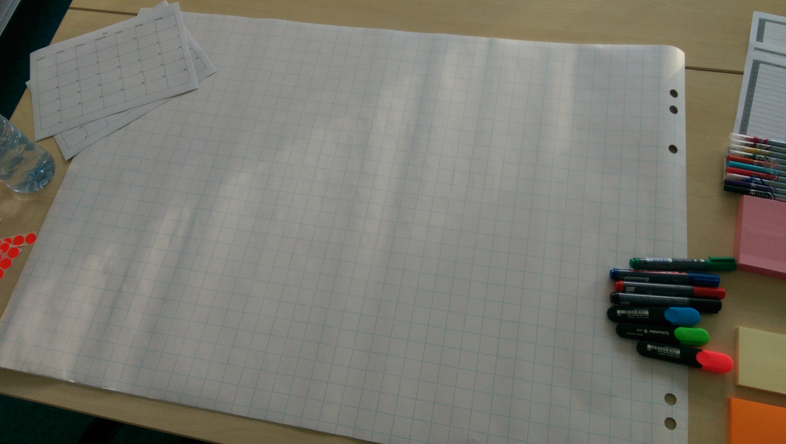
Workshop Beginning

Slide 14
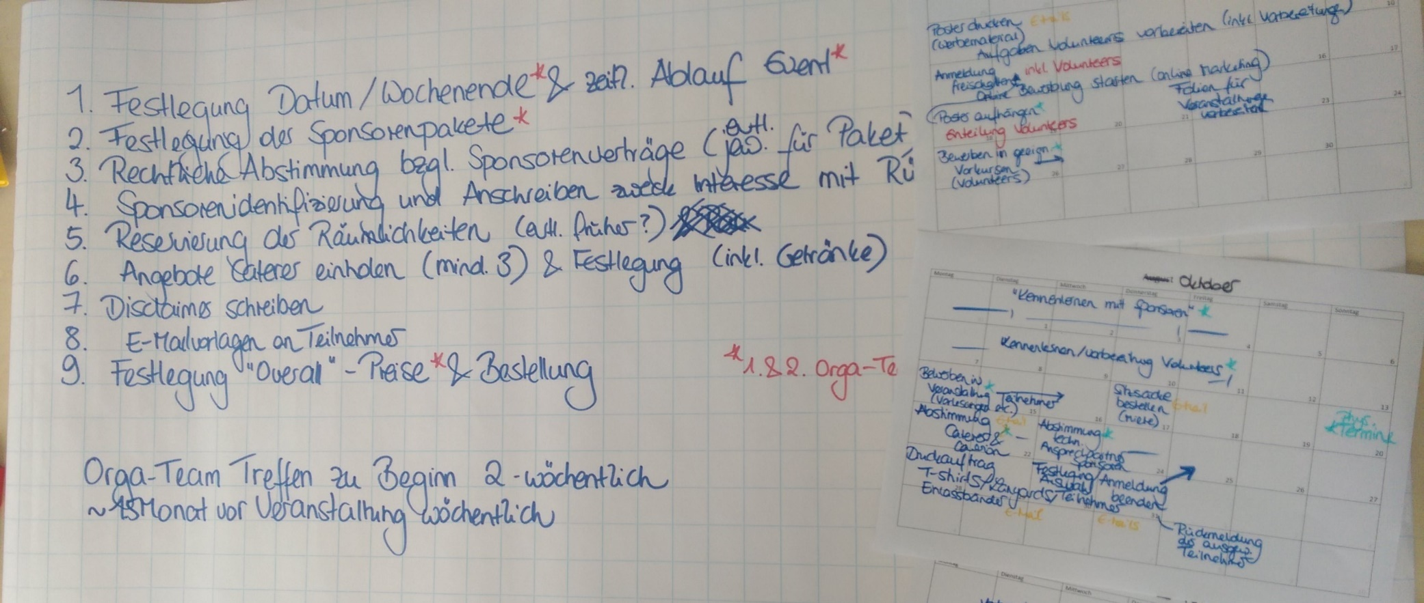
1. Workshop – Created List
Created at the beginning
Main points to talk about in the first meeting
Grew during Workshop

Slide 15
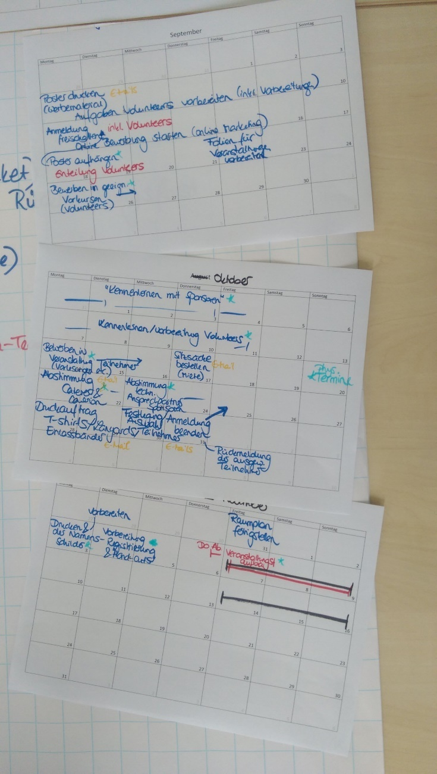
1. Workshop – Calendar based planning
Calendar used as main planning tool
Planning „backwards in time“
Tasks were assigned to weeks not exact dates
Time of tasks often changed
Tasks not described in detail
Color coding used to differentiate between categories
Tasks not assigned to team members

Slide 16
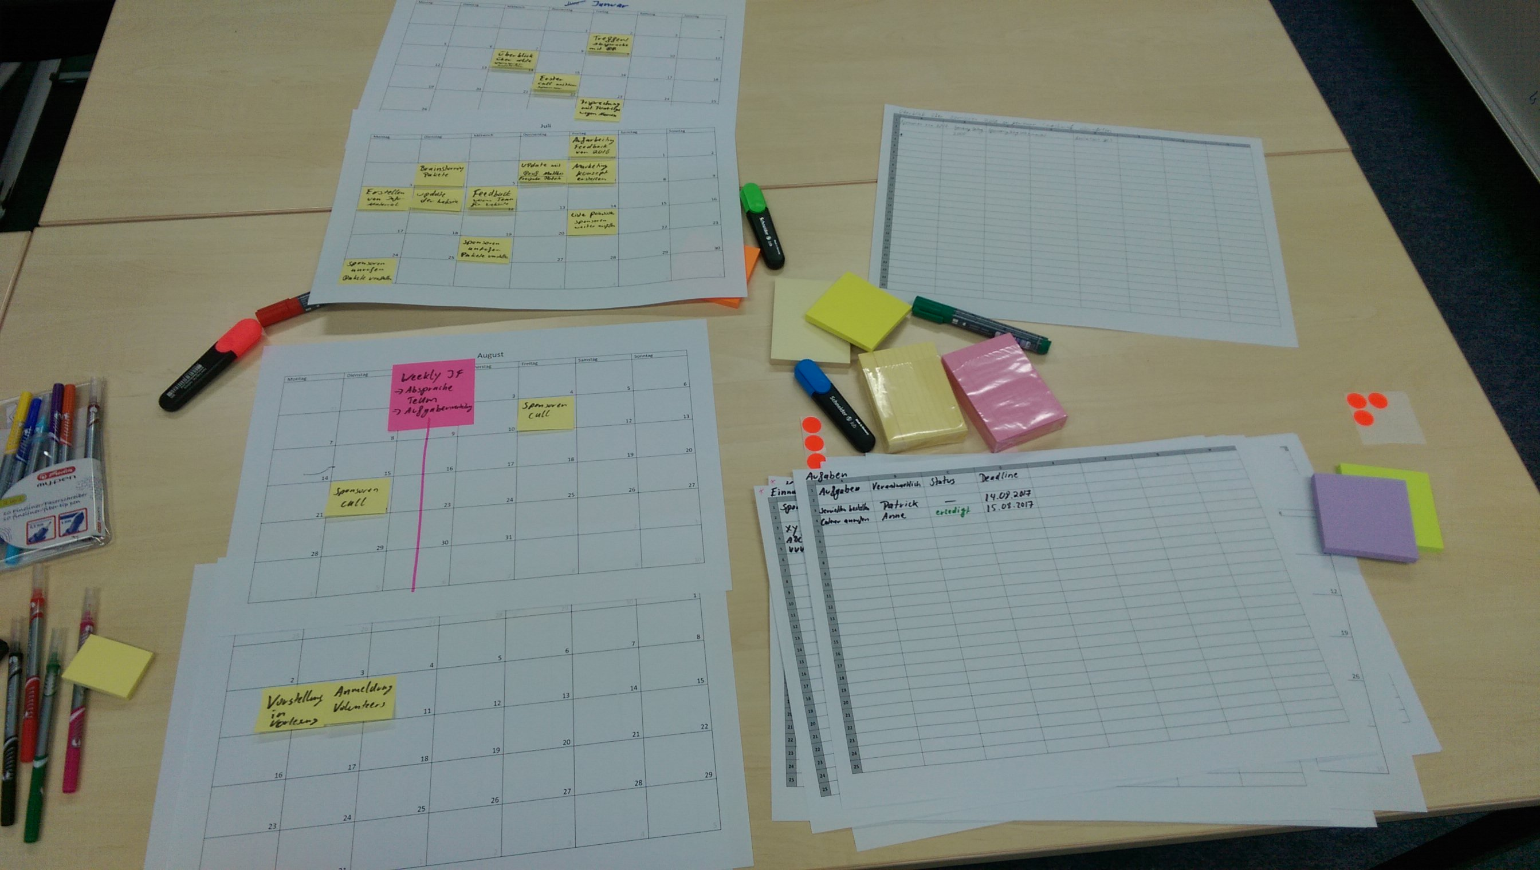
2. Workshop

Slide 17
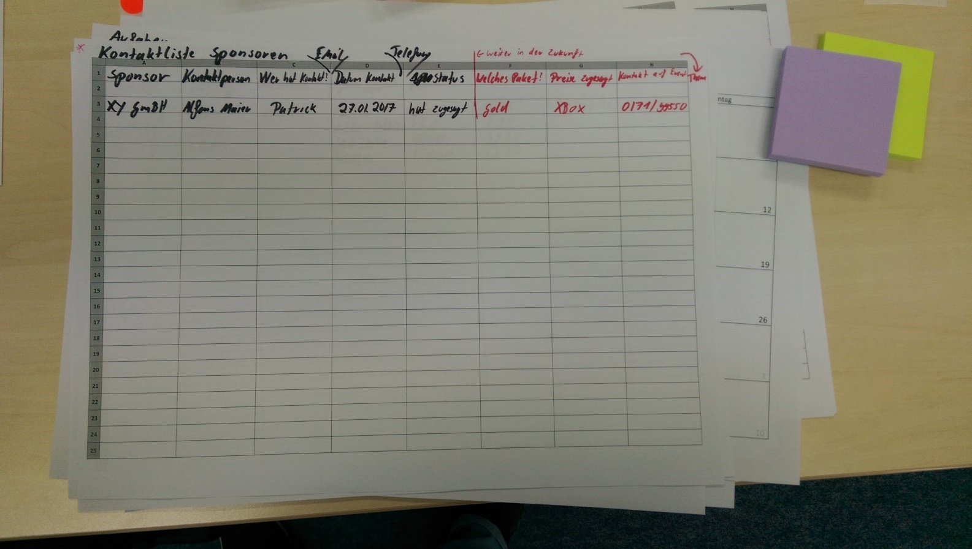
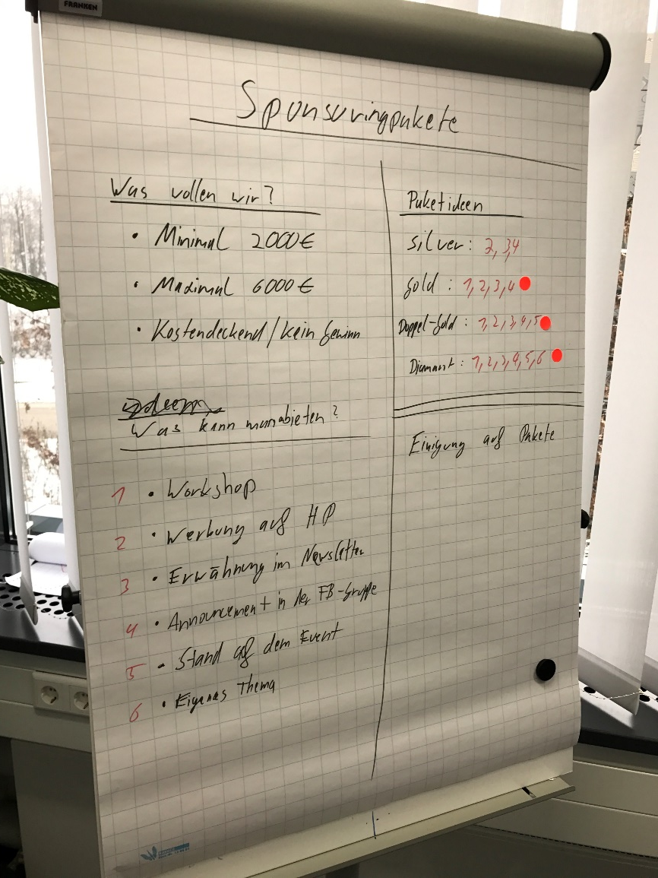
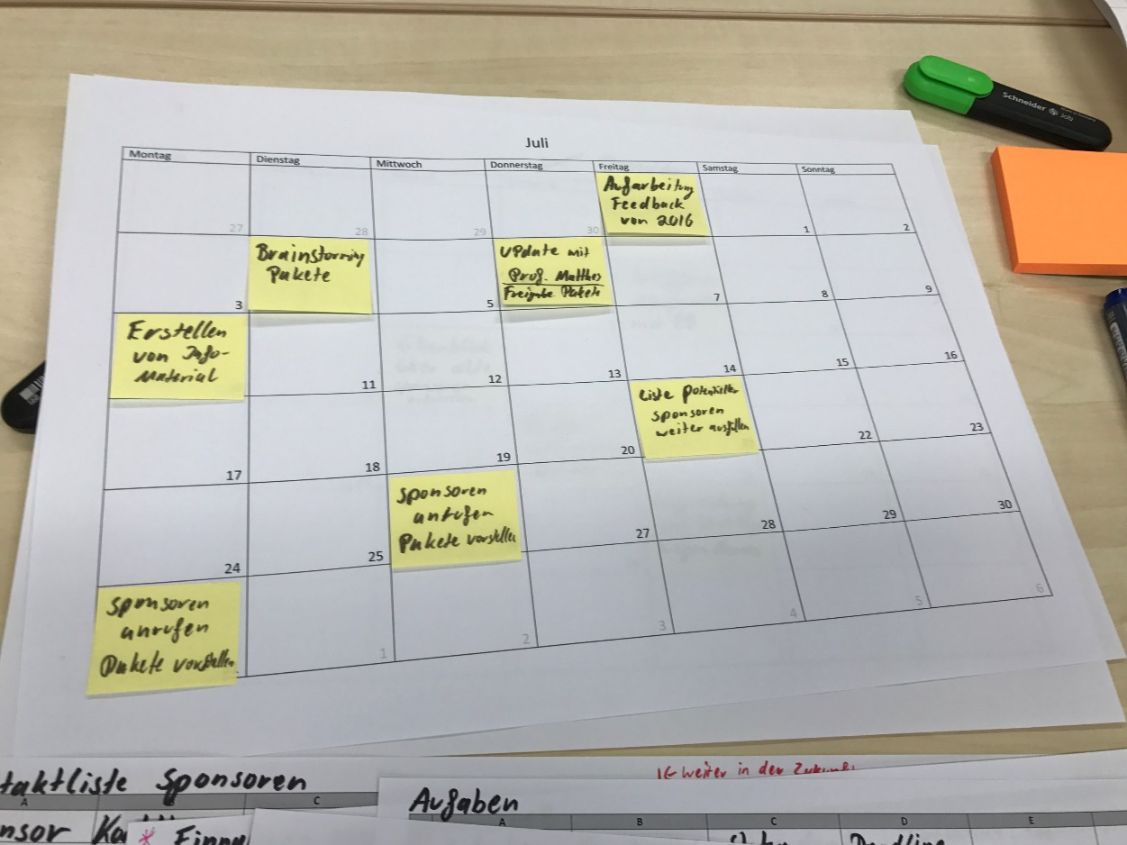
2. Workshop – used material
Calendar
Spreadsheets
Flipcharts

Slide 18
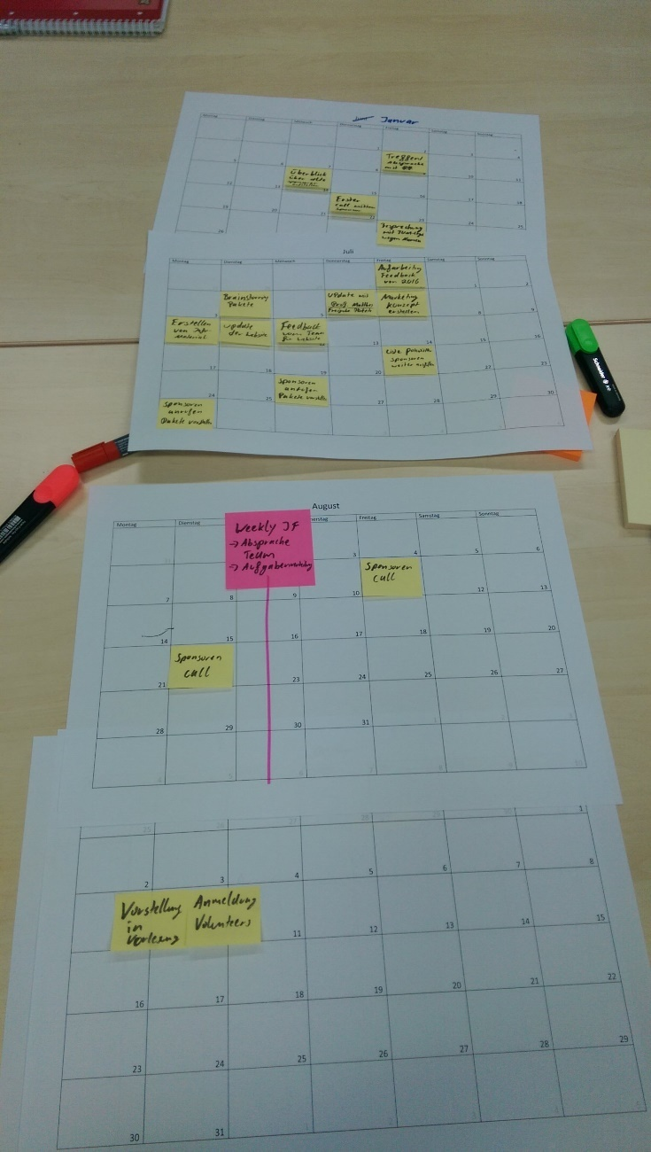
2. Workshop - Calendar
Mainly used for appointments
Rough outline of timetable

Slide 19
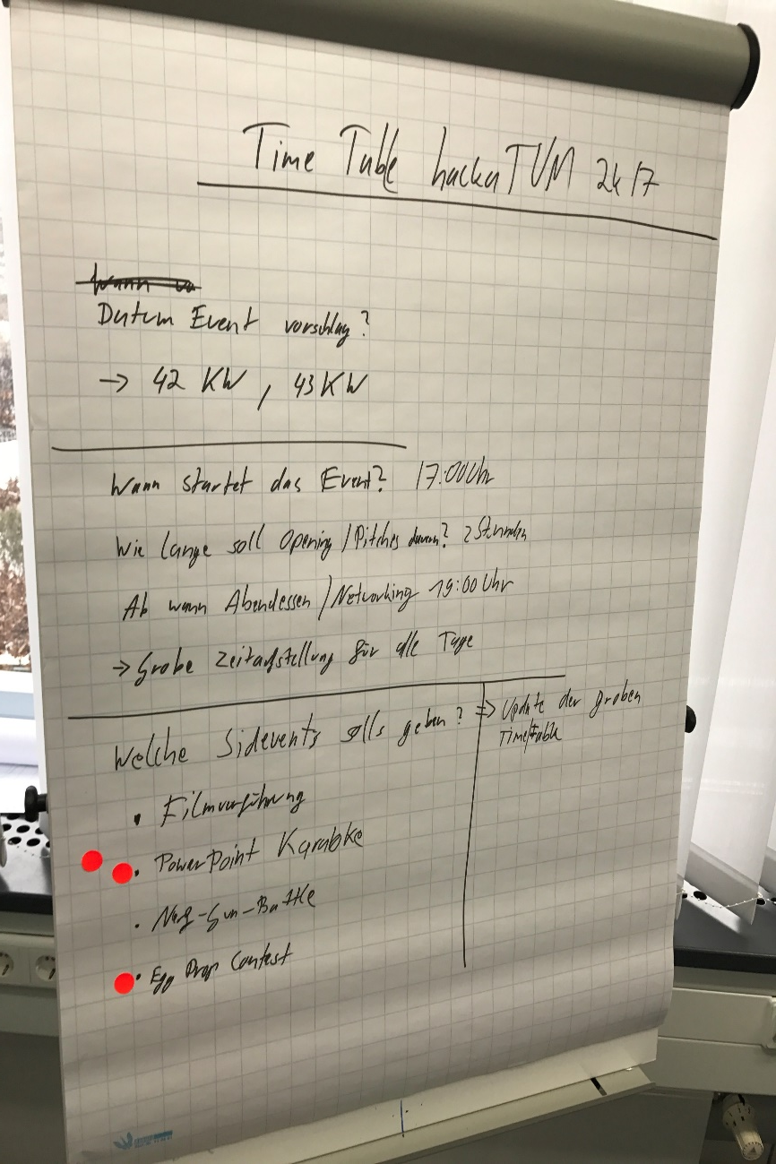
2. Workshop - Flipcharts
Used for brainstorming activities
Establishing central characteristics of event
  Brainstorming ideas
  Agreeing on ideas

Slide 20
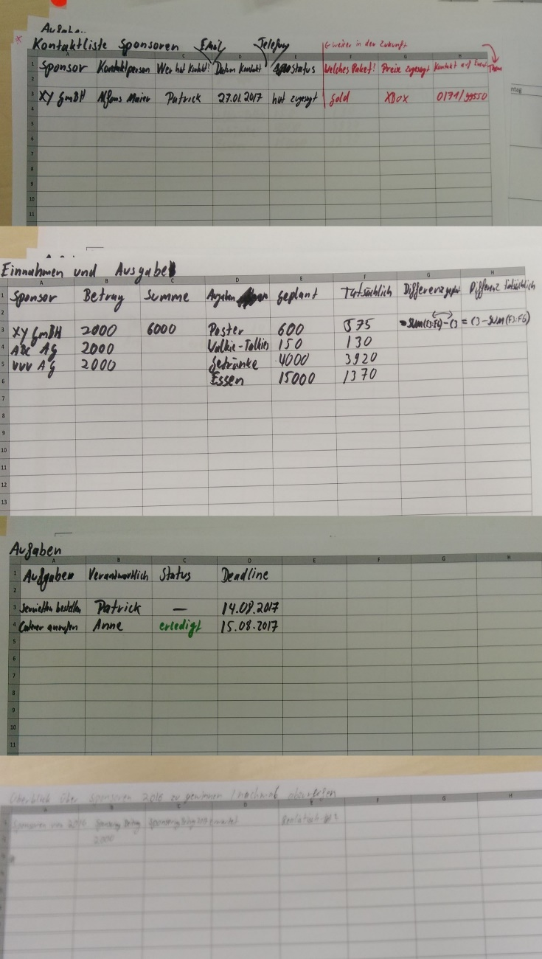
2. Workshop - Spreadsheets
4 different spreadsheets created
  Sponsors Contact list
  Financial calculation
  Task list
  Overview of last year‘s sponsors
Status fields freely editable in task list and sponsors contact list
Contact list and financial calculation most important spreadsheets
→ Repeating approach of last planning as described in interviews

Slide 21
Key Learnings
Category based grouping of tasks is useful
Month based grouping of tasks is also helpful
Difficulty of separating tasks in intermediate steps beforehand
Assigning tasks to users main advantage of using Trello
Filtering tasks based on assignments is convenient
Deadlines are often ignored, but sometimes really important
Some tasks possess recurring attributes
Email as primary communication tool irreplaceable
Updating an additional tool creates overhead
Finding stored emails to specific subjects often tricky

Slide 22
Concept Development (1)
Category based grouping of tasks is useful
Time based grouping of tasks is also helpful
→ Sorting Tasks in a list of lists
→ Base lists on categories of tasks
→ Add second view based on months of tasks
Difficulty of separating tasks in intermediate steps beforehand
→ Use a short status description for intermediate steps

Slide 23
Concept Development (2)
Assigning tasks to users main advantage of using Trello
→ Allow tasks to be assigned to users
Filtering tasks based on assignments is convenient
→ Add a filter to the board that allows the user to only see own tasks
Deadlines are often ignored, but sometimes really important
→ Allow adding deadlines to tasks
Some tasks possess recurring attributes
→ Allow adding attributes to tasks
→ Use existing Cards as Templates

Slide 24
Concept Development (3)
Email as primary communication tool irreplaceable
→ Have to be considered when designing a tool
Updating an additional tool creates overhead
→ Allow updating the tool from inside the email client
Finding stored emails to specific subjects often tricky
→ Add possibility to attach emails to cards
Add-on for used email client needed
  That allows the user to create new tasks or update an existing
  In both cases allows attaching an email to the task

Slide 25
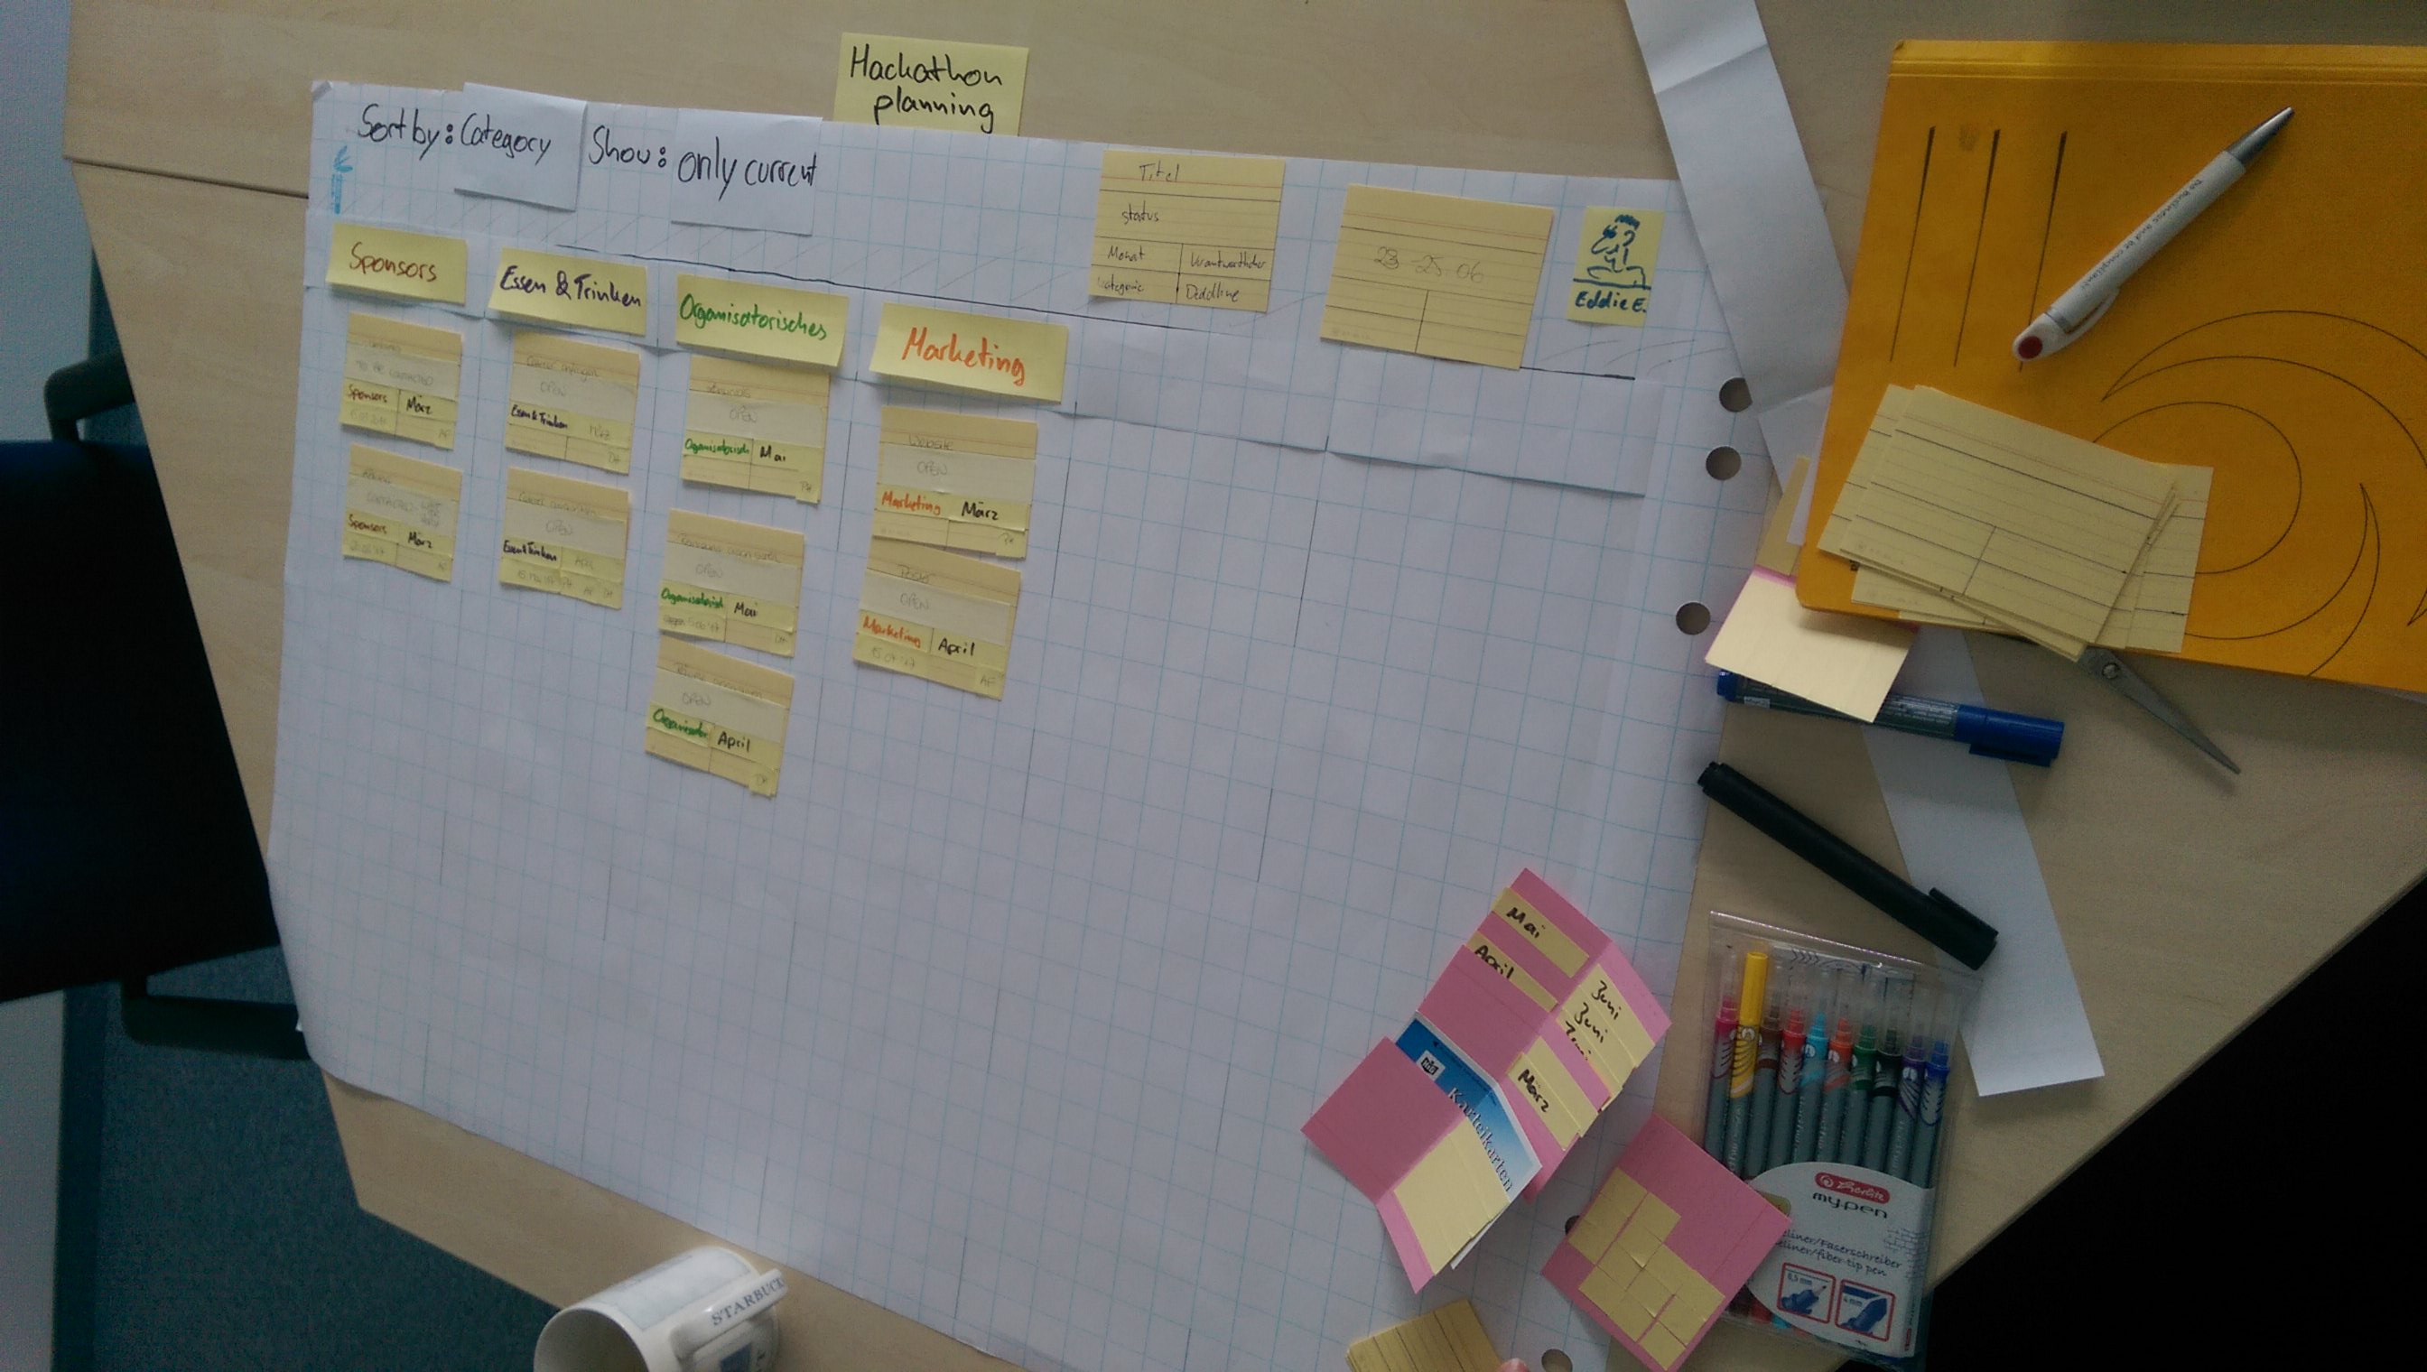
Paper Prototype – Task Board
1. Board-Title
2. View Selector
3. Filter
4. User-Menu
5. Categories

Slide 26
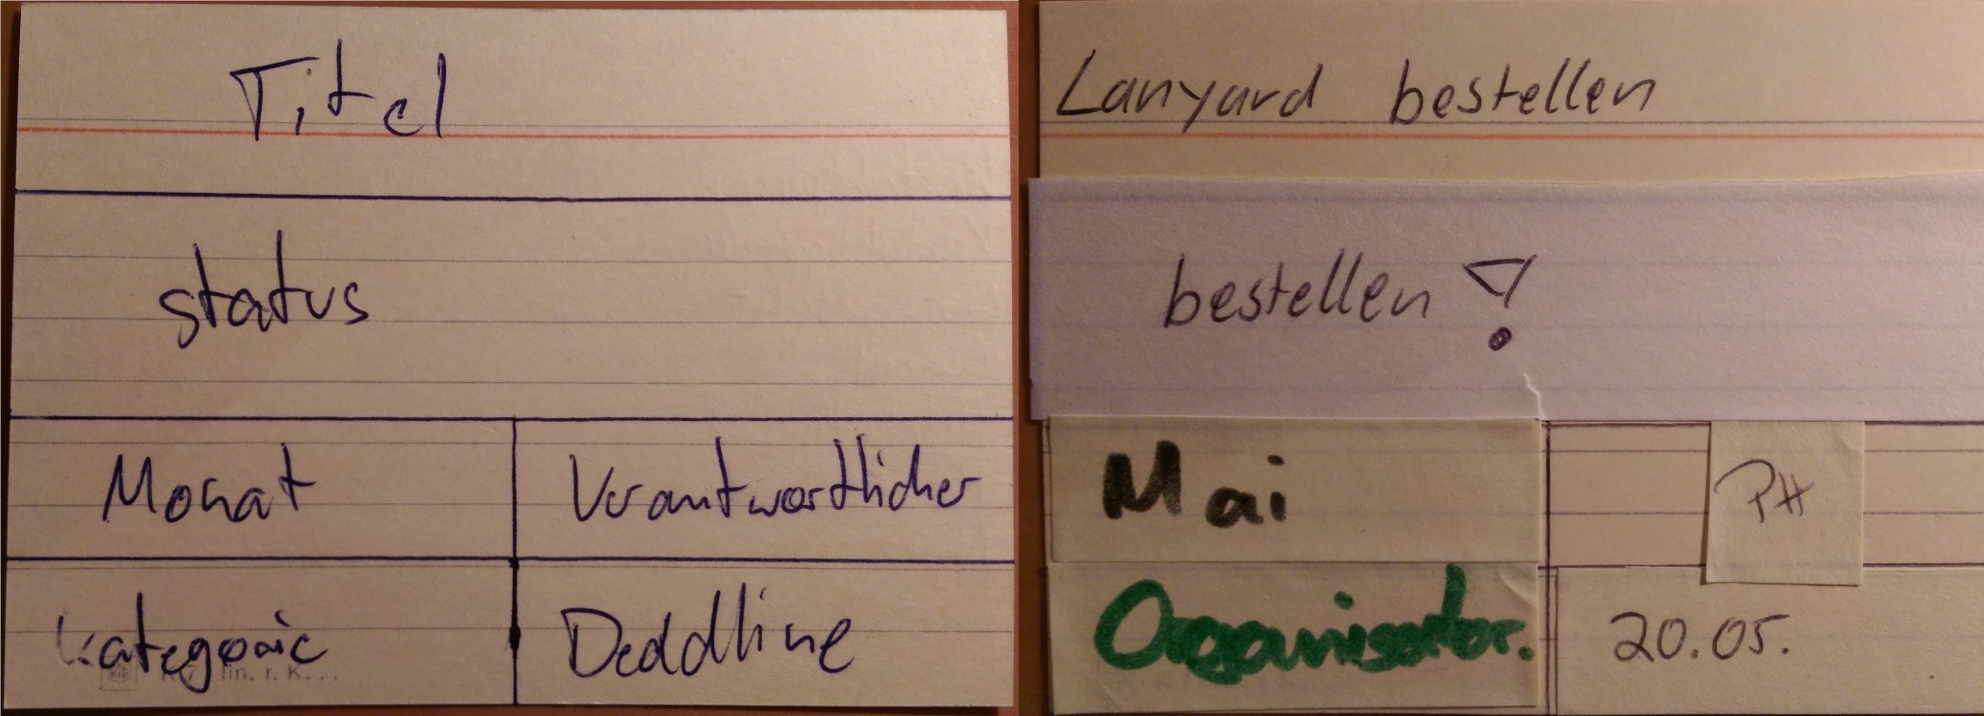
Paper Prototype – Index Cards
Each Card represents a Task
Attributes can be written on the back
Emails, represented by post-its, can be glued to the back

Slide 27
Outline
Motivation
Human-Centered Design
Approach
Hackathon Planning Process
Interviews
Workshops
Results
Evaluation
Limitations & Future Work

Slide 28
Evaluation
Methodology
  ~ 30 min usage simulation of the paper prototype
  Followed by 10 questions to concept ideas
Participants
  2 Participants from SEBIS chair
  Same participants as in interviews and workshops
Scenario
  Planning of hypothetical hackathon at June 23rd – 25th
Procedure
  Creating cards for catering, website creation, room booking, organizing posters, organizing lanyards and sponsors
  Demonstrate different views
  Updates to some of the tasks
  Updates to cards that are performed inside email client

Slide 29
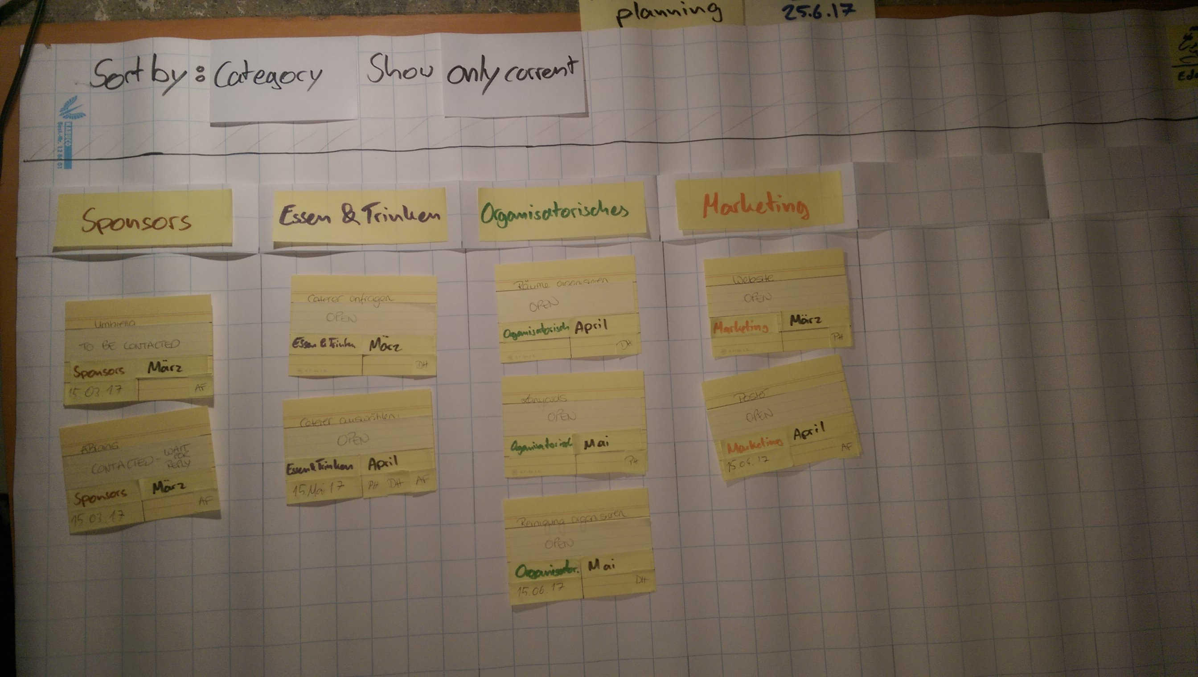
Evaluation – Board after initial task creation

Slide 30
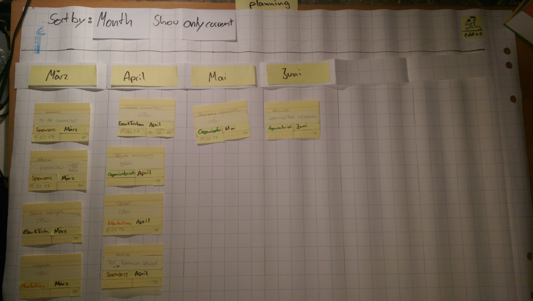
Evaluation – Board in month based view

Slide 31
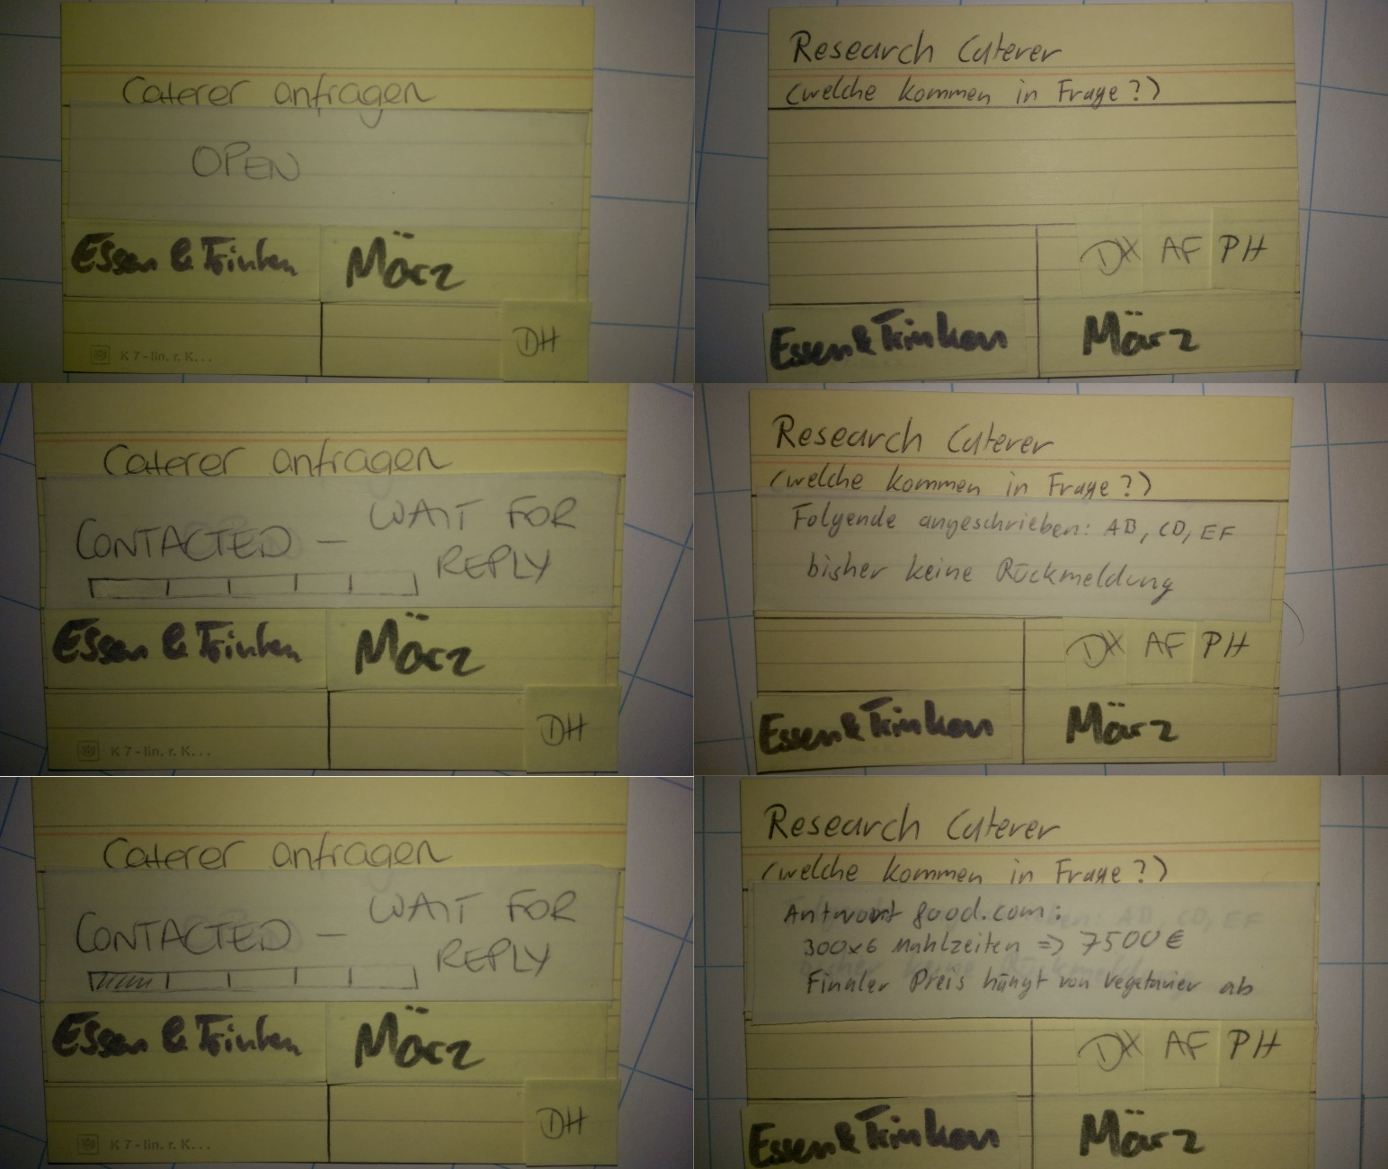
Evaluation – Evolution of Caterer Card

Slide 32
Evaluation – Results
→ concept Ideas were considered useful
Concept Idea | E1 | E2
List of Lists approach | + | +
Category & Monthly View | + | +
Freely editable Status Line | + | +
Templates for new Cards | + | +
Combination of Timeslots and Deadlines | + | +
E-mail Attachments | + | +

Slide 33
Final Adjustments
Additional View based on Team Members
Additional Filter that shows only overdue Tasks
Template based suggestions for Status

Slide 34
Balsamiq Demo

Slide 35
Outline
Motivation
Human-Centered Design
Approach
Hackathon Planning Process
Interviews
Workshops
Results
Evaluation
Limitations & Future Work

Slide 36
Limitations & Future Work
Limitations
  Only 2 Participants in all Interviews, Workshops and Evaluation
  Roles weren‘t part of the planning process
  Team members were co-located
  Context of Real Work not considered
Future Work
  Include additional process(es) in Research
    Roles should be considered
    Context of Work should be included
  Increasing fidelity of Prototype combined with usability testing

Slide 37
Prof. Dr.
Florian Matthes
17132
matthes@in.tum.de

